Slide 1
Introduction to Design

Slide 2
What is Design?
The process of creating documents that are functional, professional, and visually pleasing to the eye.
Design should considered and applied to all publications – both paper and electronic.
Good design is a process which includes 3 phases:
Plan
Create
Produce

Slide 3
Phases of Design: Plan
Set goal(s) – a clear understanding of the purpose – what are you trying to accomplish?
Determine the format – will the end result be on paper or electronic?
Analyze the audience – who a will see/read/use the publication?
Gather information, if necessary.

Slide 4
Phases of Design: Create
Develop ideas – brainstorm.
Create a theme – what is the overall “feel” of your design?
Sketch – make a preliminary drawing, aka a storyboard.

Slide 5
Phases of Design: Produce
Create & enhance typography – the size, shape and placement of text/words.
Include useful graphics – enhance the purpose; not distract.
Arrange layout – placement of text and graphics must be functional and creative.
Typeface
Type Size
Font Color

Slide 6
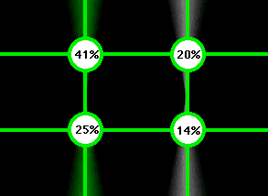
More About the “Produce” Phase
Clear & Focused – call attention to important information. – create a focal point.
Rule of Thirds – the eye tends to begin in the upper left and move to the right and downward.
White Space – the blank areas of the document – essential to create focus.

Slide 7
Other Design Considerations
Contrast – the color of text, graphics, and background should be noticeably different.
Balance – the publication should be visually “balanced”.
Balance doesn’t necessarily mean the same.
Perception – how will the intended audience “see” your design?

Slide 8
Design should be a part of everything you create.

